Slide 1
Global CPG & Retail University
Tampa Florida
March 6, 2002
Solution Set Breakout:
Retail Gets Real
Growth Strategies for the New Millennium
Herb Kleinberger, Karl Haller

Slide 2
NOTE: This presentation is considered a “working draft.” Please do not distribute outside PwC without approval from one of the contacts listed on p25.
Contact Kathryn Cordes for the most up-to-date version

Slide 3
Session Objectives
  Explain the purpose and mission of the POV
    Servicing our clients
    Growing the business
    Aligning our resources and solution sets to client needs
  Review the high points of the POV itself
  Explain how we will roll out Retail POV to strategic and managed accounts globally
  Learn who to contact for support and more information

Slide 4
What is a Point of View?
The Retail POV is:
  Our take on overall industry direction and future trends, and their impact on the retail environment
  A high-level prescription of requirements for future success
It supports our objectives by:
  Providing market visibility for the practice
  Allowing us to more effectively engage business management on their key issues
  Serving as a consistent framework around which our array of services / solutions can be positioned
Notes:
Edgy and provocative

Slide 5

Near-Term Retail Outlook
  A post-September 11th world
  Global recession ending?
  Flight to value
  Enron aftermath

Slide 6
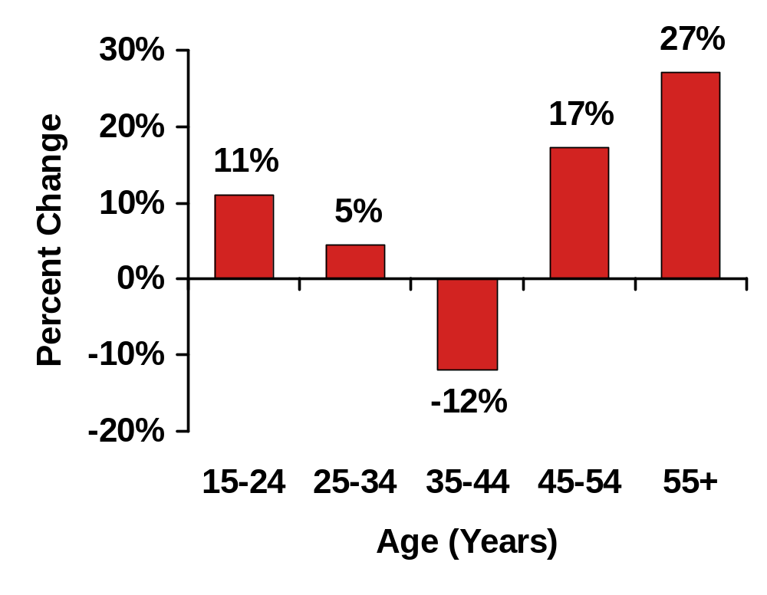
Longer Term Forces of Change
US Population Growth
2000 – 2010
Consumers
  Consumer Conundrum
  Age Wars
  Multi-plex demands
SOURCE: US Census Department

Slide 7
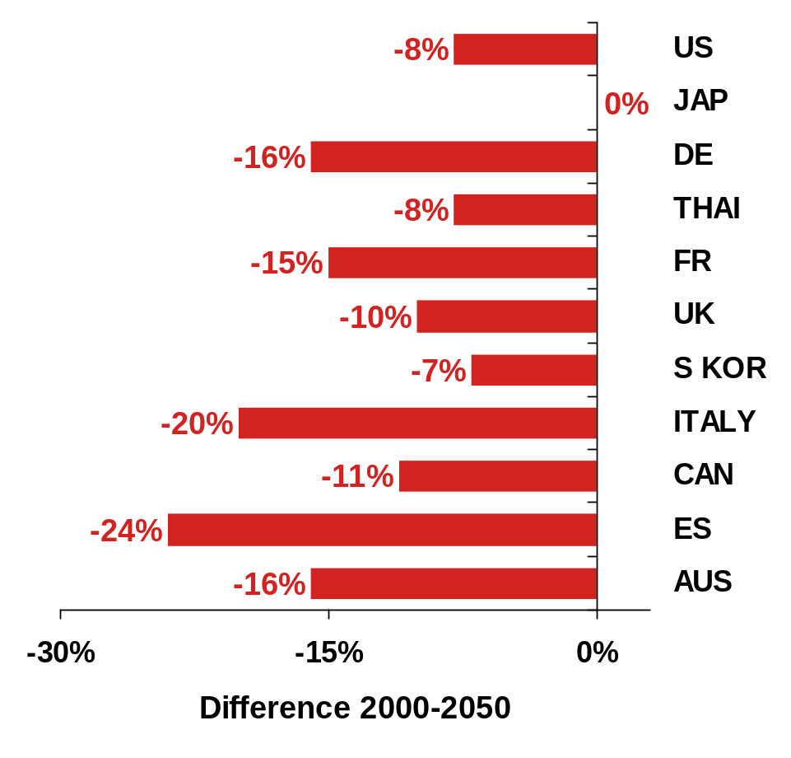
Longer Term Forces of Change
Relative Labor Force Participation 2000-2050
Consumers
  Consumer Conundrum
  Age Wars
  Multi-plex demands
NOTE: Relative Labor Force Participation measures percent of population in the labor force
SOURCES: UN, Govt. Data, Population Council

Slide 8
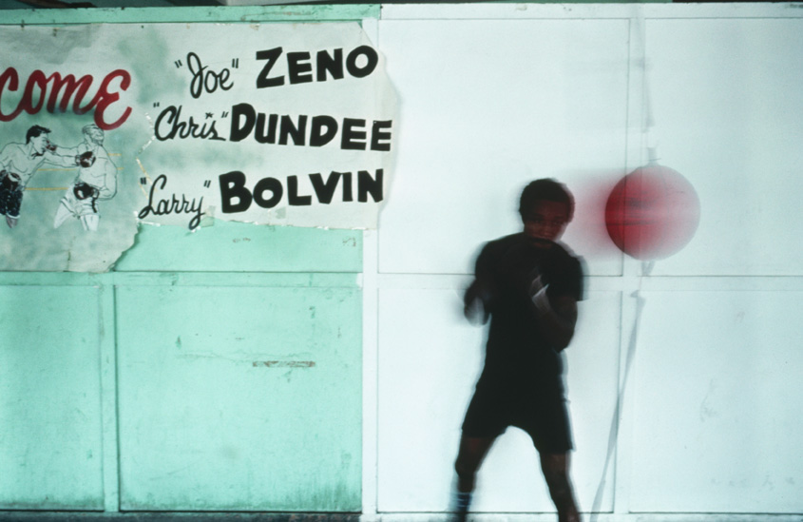
Longer Term Forces of Change
Consumers
  Consumer Conundrum
  Age Wars
  Multi-plex demands
Competition … Oversupply of everything
  Maturity abounds
  Format and channel blurring
  Convergence is coming
“We are living in a Surplus Society … where similar companies employ similar people, working in similar jobs, coming up with similar ideas, producing similar things.”
- Kjell Nordstrom & Jonas Kidderstrale

Slide 9
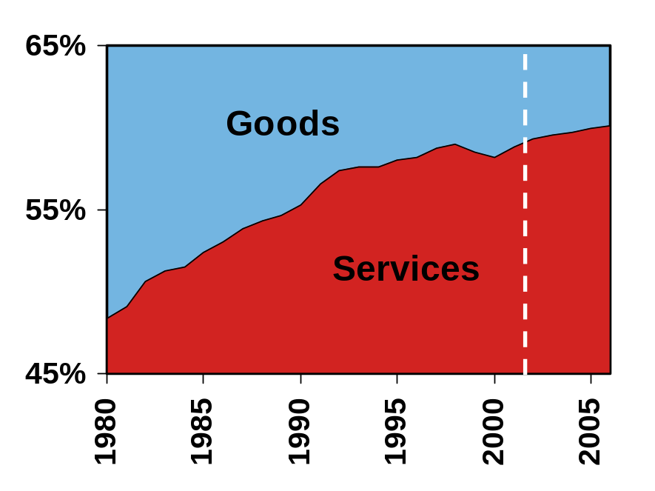
Longer Term Forces of Change
US Personal
Consumption
Expenditures (PCE)
Consumers
  Consumer Conundrum
  Age Wars
  Multi-plex demands
Competition … Oversupply of everything
  Maturity abounds
  Format and channel blurring
  Convergence is coming
Services become the new battleground
SOURCE: US Bureau of Labor Statistics and Retail Forward

Slide 10

Implications
  Retail redefined: Everyone becomes
  a retailer
  Globalization, consolidation continue
  Big winners, big losers
  Brand battles
  From products to solutions

Slide 11
The Challenge Remains the Same …
The Retail Challenge
Right Product
Right Place
Right Time
Right Price
Right Way

Slide 12
The Challenge Remains the Same … But The Approach Must Change
The Retail Challenge
To Win, Retailers Must
Get Real
Right Product
Right Place
Right Time
Right Price
Right Way
Real Focused
Real Efficient
Real Smart
Real Close
All in Real Time
Sustainable growth will come from an increased understanding of consumers and the ability to meet their multi-plex needs

Slide 13
Real Focused:
Defining Positioning Elements
  Consumer segments
  Occasions / need-states
  Product mix
  Solutions
  Traditional competitors
  Emerging competitors
  Key differentiators
    Quality
    Experience
    Price
    Convenience
    Service
    Selection
    In-stock
  Key differentiators
    Quality
    Experience
    Price
    Convenience
    Service
    Selection and in-stock less viable on their own
Notes:
Add notes

Slide 14






Real Focused:
Four Primary Business Models Will Emerge
SELF EXPRESSION
Opportunist
(The Thrill of the Hunt)
Lifestylist
(My Personal Assistant)
PRODUCTS
SOLUTIONS
Commoditizer
(Get it Here, Cheap)
Solver
(Solutions for Everyday Life)
BASIC NEEDS

Slide 15
Real Efficient:
Traditional Productivity Loop Isn’t Enough
Lower
Prices
Increase
Sales /
Market Share
Lower Costs /
Economies
of Scale
Retail
Productivity
Loop
More
Gross Margin
Dollars
Greater
Productivity
Reinvest in
Technology

Slide 16
Real Efficient:
Across the Enterprise
  Collaborative Value Chains – Next stage of supply chain optimization
    CPFR – planning, forecasting, replenishment
    CPC – collaborative product commerce
  Six Sigma – Process quality improvement comes to retail
  Asset Management
    People – Enterprise portals
    Places – Flexible lease arrangements
    Things – Outsourcing of non-core functions
  Price Management – Variable pricing based on customer / need
  Financial Controls – Emphasis on balance sheet and cash
A mixture of “Art” and “Science” is required

Slide 17
Real Smart:
Multi-Plex Consumer Value Drivers
More
Service
Service
Fashion
Fashion
Consistency
Selection
Information
Selection
Community
Atmosphere
Quality
Convenience
Quality
Convenience
Price
Effort
Price
Time
Risk
Time
For Less

Slide 18
Real Close:
Business Model Alignment
Commoditizer
Opportunist
Solver
Lifestylist
Strategy
Organization / Culture
Metrics / Measures
Operations / Technology

Slide 19
Real Close:
Business Model Alignment
SELF EXPRESSION
Opportunist
Speed
Lifestylist
One-to-One
PRODUCTS
SOLUTIONS
Commoditizer
“Glocal”
Solver
High-Touch
BASIC NEEDS

Slide 20
How To Get REAL
Get
Ready
Get
Engaged
Get
Active
Get
aLigned
“Stable” positioning and productivity (i.e. business model generates sufficient free cash flow)
Real Focused – develop potential future scenarios and positioning options
  Multi-plex consumer
  Emerging compet-itive environment
  Key differentiators
Build and/or improve capabilities
  Real Smart
  Real Efficient
Real Close – Business Model Alignment
  Operations
  Organization
  Metrics
Getting Real will require doing business in real time

Slide 21

Real Time Retail – Driving Growth at the Point of Decision
Real-time connections with:
  Consumers
  Stores
  Trading Partners
Significant impact on:
  Purchasing
  Inventory Management
  Pricing / Promotions
  Customer Service
Technology-enabled
  Collaborative Value Chains
  RFID / Auto-ID
  “E” enabled POS / Kiosks
  In-store wireless CRM
  Multi-channel

Slide 22

Innovation is the only constant
“All strategies eventually fail”
Dr. Bert McCammon,
Co-founder,
Management Horizons

Slide 23
Ongoing POV Development

Slide 24
Services and Solution Set Linkage
Transformation
Get
Ready
Get
Engaged
Get
Active
Get
aLigned
“Stable” positioning and productivity (i.e. business model generates sufficient free cash flow)
Real Focused – develop potential future scenarios and positioning options
  Multi-plex consumer
  Emerging compet-itive environment
  Key differentiators
Build and/or improve capabilities
  Real Smart
  Real Efficient
Real Close – Business Model Alignment
  Operations
  Organization
  Metrics
Diagnostics
CVCS
B2E
SCS
SPI
CRM Accel
iAnalytics
ERP
iAnalytics

Slide 25
Marketing & Media
  Client presentations
  White Paper report
  Website / NoEI content
  Media / Press coverage
  External / Industry presentations
  Client Team briefings
  Internal communiqués

Slide 26
Key Contacts
  Americas Herb Kleinberger
  EMEA Bill Gilmour
  AsiaPac Stuart Harker
  Marketing Kathryn Cordes
NOTE: This presentation is considered a “working draft.” Please do not distribute outside PwC without approval from one of the contacts listed above.
Contact Kathryn Cordes for the most up-to-date version

Slide 27
PwC ConsultingTM refers to the management consulting services businesses of the member firms of the worldwide PricewaterhouseCoopers organisation.
© 2002 PricewaterhouseCoopers. All rights reserved.

